Slide 1
DATA SCIENCE
11 WEEK PART TIME COURSE
Week 5 - Recommendation Engines
Wednesday 20th April 2016

Slide 2


Slide 3
AGENDA
Mid-Course Surveys!
What are Recommendations? (You tell me)
What is the motivation of recommendations?
What is Content-Based Filtering?
What is Collaborative Filtering?
Measuring Accuracy
Lab
Other Considerations
Discussion

Slide 4
WHAT ARE RECOMMENDATION ENGINES?
DATA SCIENCE PART TIME COURSE

Slide 5
RECOMMENDATION ENGINES
What are recommendations?
Why are they important?
Give one example people are likely to come across?
Work in two groups to answer the above questions and present back to the class.
5 mins

Slide 6



RECOMMENDATION ENGINES
Recommendation engines aims to match users to things (movies, songs, items, events, etc) they might enjoy but have not yet tried.
The rating is produced by analysing other user/item ratings (and sometimes item characteristics) to provide personalised recommendations to users.

Slide 7

DATA SCIENCE PART TIME COURSE

Slide 8
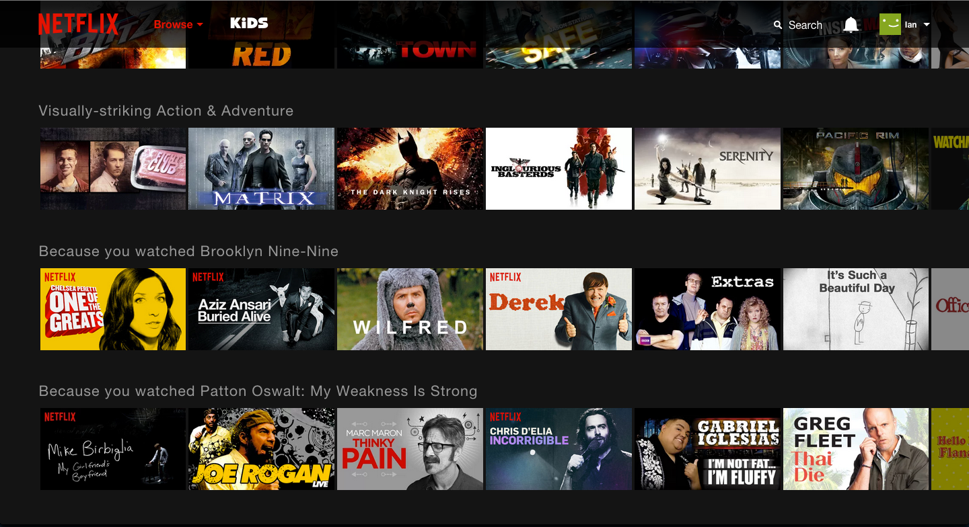
Netflix - Entertainment or Data Science?

Slide 9
Netflix - Entertainment or Data Science?

Slide 10
Netflix - Entertainment or Data Science?

Slide 11
Netflix - Entertainment or Data Science?

Slide 12

Netflix - Entertainment or Data Science?

Slide 13
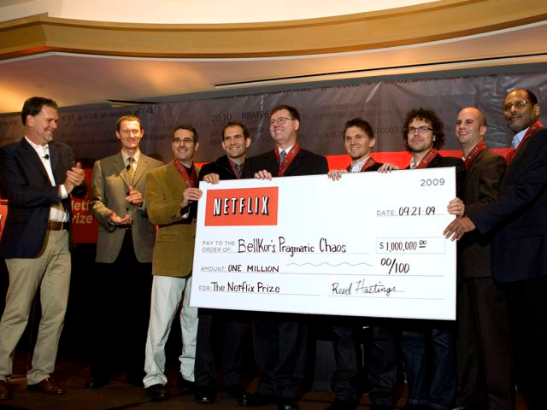
Netflix - Entertainment or Data Science?

Slide 14
RECOMMENDATION ENGINES
There are two general approaches to the design:
In content-based filtering, items are mapped into a feature space, and recommendations depend on item characteristics.
In contrast, the only data under consideration in collaborative filtering are user-item ratings, and recommendations depend on user preferences.

Slide 15
CONTENT-BASED FILTERING
DATA SCIENCE PART TIME COURSE

Slide 16
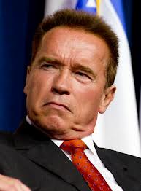


CONTENT-BASED FILTERING
Looking at attributes of an item, you then make recommendations based on how similar those items are.
You liked Predator with Arnold Schwarzenegger you might also like The Terminator (because Arnie’s in that too).

Slide 17
CONTENT-BASED FILTERING
Content-based filtering begins by mapping each item into a feature space. Both users and items are represented by vectors in this space.
Item vectors measure the degree to which the item is described by each feature, and user vectors measure a user’s preferences for each feature.
Ratings are generated by taking dot products of user & item vectors.

Slide 18
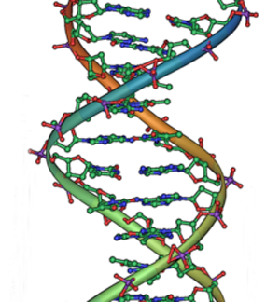
CONTENT-BASED FILTERING
Pandora is an example of Content-Based filtering. A massive taxonomy of musical information. Trained musical analysts identify over 450 musical characteristics (lookup the Music Genome Project).

Slide 19
CONTENT-BASED FILTERING
Content-based filtering has some difficulties:
Must map items into a feature space (manual work)
Recommendations are limited in scope (items must be similar to each other)
Hard to create cross-content recommendations (eg books/music films...this would require comparing elements from different feature spaces)

Slide 20
COLLABORATIVE FILTERING
DATA SCIENCE PART TIME COURSE

Slide 21
COLLABORATIVE FILTERING
“Customers who purchased X also purchased Y”
Someone with similar tastes to you will be able to recommend things you might like, e.g. people who watch ‘The Newsroom’ will probably enjoy ‘The Social Network’ because there is a large audience in common.

Slide 22
COLLABORATIVE FILTERING
Collaborative filtering refers to a family of methods for predicting ratings where instead of thinking about users and items in terms of a feature space, we are only interested in the existing user-item ratings themselves.
In this case, our dataset is a ratings matrix whose columns correspond to items, and whose rows correspond to users.

Slide 23
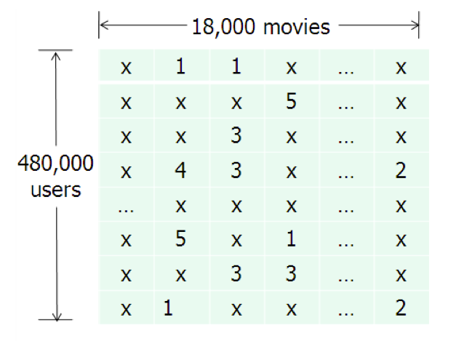
COLLABORATIVE FILTERING
This will be the general form of the data we analyse for collaborative filtering.
The method relies on previous user-item ratings (or feedback).

Slide 24
COLLABORATIVE FILTERING
Collaborative filtering is susceptible to the Cold Start problem.
What happens if we don’t have any (or enough) reviews?

Slide 25
COLLABORATIVE FILTERING
Collaborative filtering is susceptible to the Cold Start problem.
What happens if we don’t have any (or enough) reviews?
Until users rate several items, we don’t know anything about their preferences.
We can get around this by enhancing our recommendations using implicit feedback, which may include things like item browsing behaviour, search patterns, purchase history, etc. Or by using a hybrid model.

Slide 26
SIMILARITY SCORES
DATA SCIENCE PART TIME COURSE

Slide 27
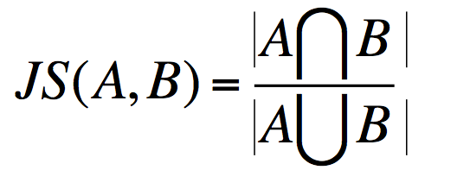
JACCARD SIMILARITY
Jaccard Similarity:
Defines similarity between two sets of objects

Slide 28
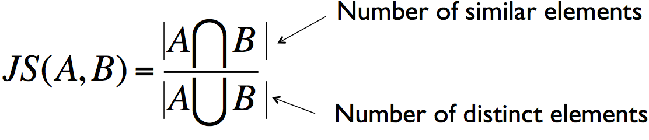
JACCARD SIMILARITY
Jaccard Similarity:
Defines similarity between two sets of objects

Slide 29
JACCARD SIMILARITY
JS ({1, 2, 3}, {2,3,4}) = {2,3} / {1,2,3,4}
= 2/4
= 1/2

Slide 30
JACCARD SIMILARITY
User one: {“Target”,“Banana Republic”,“Old Navy”}
User two: {“Banana Republic”,“Gap”,“Kohl’s”}
JS (User one, User two) =

Slide 31
JACCARD SIMILARITY
User one: {“Target”,“Banana Republic”,“Old Navy”}
User two: {“Banana Republic”,“Gap”,“Kohl’s”}
JS (User one, User two) = 1/5

Slide 32
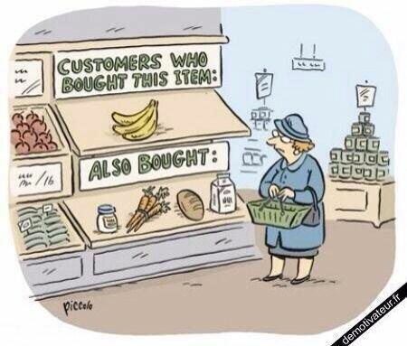
LAB
DATA SCIENCE PART TIME COURSE

Slide 33

SYNCHING A FORK
git remote -v
git remote add upstream https://github.com/ihansel/SYD_DAT_4.git
git remote -v
git fetch upstream
git checkout master
git merge upstream/master
OR git reset --hard upstream/master

Slide 34
OTHER CONSIDERATIONS
DATA SCIENCE PART TIME COURSE

Slide 35
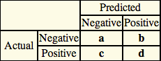
MEASURING ERROR
Accuracy = Correct Recommendations / Total Possible Recommendations
= (a + d )/(a + b +c + d)
Precision = Correctly Recommended Items / Total Recommended Items
= d / (b + d)
Recall = Correctly Recommended Items / Total Useful Recommended Items
= d / (c + d)
Precision ~1 means the algorithm returned more relevant results than irrelevant.
Recall ~1 means that an algorithm returned most of the relevant results.

Slide 36

EXPLICIT VS IMPLICIT DATA
Explicit data is when you ask the user to rate something, e.g. 1-5 star rating for a movie
Implicit data is when you observe a users behaviour and record

Slide 37
ALGORITHMS
Alternating Least Squares (ALS)
Stochastic Gradient Descent (SGD)
Singular Value Decomposition (SVD)
Factorization Machine (FM)
Collaborative Less is More Filtering (CLiMF)

Slide 38
MODEL OBJECTIVES
Ranking
Freshness
Diversity
Social Recommendations
Context Aware Recommendations
Hybrid Models (Combining Content based filtering and Collaborative filtering)
Model Objectives (what are you trying to optimise)
Sequences?

Slide 39
DISCUSSION TIME
Week 5
Homework 2
Project
DATA SCIENCE - Week 5 Day 2

Slide 40
WEEK 5

Slide 41
HOMEWORK 2
Overview
Describe linear Regression
Relate what we’ve learned in class to practical skills mentioned in a paper
Work on your projects
DATA SCIENCE - Week 5 Day 2

Slide 42
PROJECT
DATA SCIENCE - Week 5 Day 2

